Slide 1
?
CSS

Slide 2
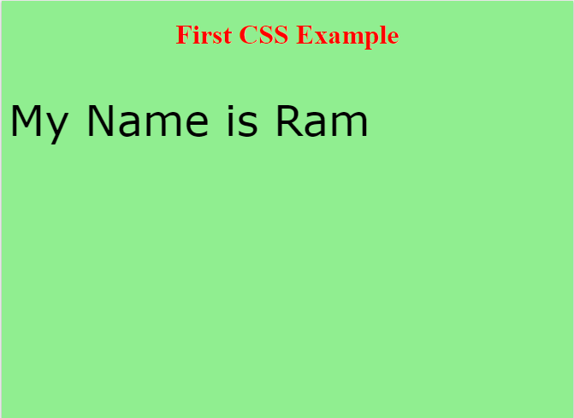
WHY CSS?
<!DOCTYPE html>
<html>
<head>
<style>
body {
background-color: lightgreen;
}
h1 {
color: red;
text-align: center;
}
p {
font-family: verdana;
font-size: 50px;
}
</style>
</head>
<body>
<h1>First CSS Example</h1>
<p> My Name is Ram </p>
</body>
</html>
provide background colour to the page
provide colour and alignment to the heading of the page
provide colour and size to the content of the page

Slide 3
WHY CSS?
HTML is used to create content of a web page whereas CSS is used to give designs to those content of the web page.
CSS provides presentation to different types of devices irrespective of the screen size.
Redesign your website easily and quickly.
WHAT IS CSS?
CSS stands for Cascading Style Sheets
CSS is a style sheet language used to make webpages more presentable which are written using HTML elements.

Slide 4
CSS SYNTAX
CSS Syntax consist of following two parts:
h1 {
color: red;
text-align: center;
}
Declaration consist of two parts :
color: red;
SELECTOR
DECLARATION BLOCK
PROPERTY
VALUE
SELECTOR points to HTML element for which you want style
Each DECELARATION BLOCK consists of more than one declaration separated by a semicolon (;).
Each declaration consist of property and value pair.

Slide 5
CSS SELECTOR
Used to find HTML elements based on their name, id, class, attribute and more.
1. The element Selector :
p {
text-align: center;
}
<p id="para1">How are you?</p> /* Here the selection is based on element i.e <p> */
2. The id Selector :
#para {
text-align: center;
color: red;
}
<p id="para">How are you?</p> /* Here the selection is based on id i.e “para” */
3. The class Selector :
.center {
text-align: center;
color: red;
}
<h1 class="center"> How are you?</h1> /* Here the selection is based on class i.e “.center” */
Notes:
Explain the Grouping Selector

Slide 6
WAYS TO INSERT CSS
1. External Style Sheet : In External Style Sheet the file should be mentioned in the <link> element and the <link> element resides inside the <head> element.
Example: <head> <link rel="stylesheet" type="text/css" href=“externalstyle.css"> </head>
2. Internal Style Sheet : In Internal Style Sheet the internal styles are mentioned in the same page within the <style> element, which is inside the <head> element.
Example: <head> <style> body { background-color: blue; }
</style> </head>
3. Inline Style Sheet : An inline style is used to apply style on a single element.
Example: <h1 style="color:blue;">My CSS File</h1>
Notes:
Explain Multiple Style Sheets
Example
Assume that an external style sheet has the following style for the <h1> element:
h1 { color: navy; }
then, assume that an internal style sheet also has the following style for the <h1> element:
h1 { color: orange; }
If the internal style is defined after the link to the external style sheet, then the <h1> element will be "orange“ and not “navy”:
<head> <link rel="stylesheet" type="text/css" href="mystyle.css"> <style> h1 { color: orange; } </style> </head>

Slide 7
?
BOOTSTRAP

Slide 8
Bootstrap has responsive features.
Bootstrap is compatible with mostly all browsers.
WHY BOOTSTRAP?
WHAT IS BOOTSTRAP?
Bootstrap is used to create free front-end framework which can automatically adjust in any device irrespective of it’s screen size.
Bootstrap also gives you the ability to easily create responsive designs.

Slide 9
Include the HTML5 doctype at the beginning of the page, along with the lang attribute and the correct character set as follows :
<!DOCTYPE html> <html lang="en"> <head> <meta charset="utf-8"> </head> </html>
To ensure proper rendering and touch zooming, add the following <meta> tag inside the <head> element:
<meta name="viewport" content="width=device-width, initial-scale=1">
To wrap site contents containing elements are required.
1. The .container class provides a responsive fixed width container
2. The .container-fluid class provides a full width container, spanning the entire width of the viewport
How To Create Web Page with Bootstrap

Slide 10
GRID SYSTEM
Bootstrap’s grid system allows 12 columns across the page.
The grid system has 4 classes :
xs (for phones)
sm (for tablets)
md (for small laptops)
lg (for laptops and desktops)
Basic structure of Bootstrap grid :
<div class="row"> <div class="col-*-*"></div> <div class="col-*-*"></div> </div> <div class="row"> <div class="col-*-*"></div> <div class="col-*-*"></div> <div class="col-*-*"></div> </div> <div class="row"> ... </div>
Add the desired number of columns but it should always add up to 12 for each row

Slide 11

BUTTON CLASSES
Class | Description | Example
.btn | Adds basic styling to any button
.btn-default | Indicates a default/standard button
.btn-primary | Provides extra visual weight and identifies the primary action in a set of buttons
.btn-success | Indicates a successful or positive action
.btn-info | Contextual button for informational alert messages
.btn-warning | Indicates caution should be taken with this action
.btn-danger | Indicates a dangerous or potentially negative action
.btn-link | Makes a button look like a link (will still have button behavior)
.btn-lg | Makes a large button
.btn-sm | Makes a small button
.btn-xs | Makes an extra small button
.btn-block | Makes a block-level button (spans the full width of the parent element)
.active | Makes the button appear pressed
.disabled | Makes the button disabled
.navbar-btn | Vertically aligns a button inside a navbar

Slide 12
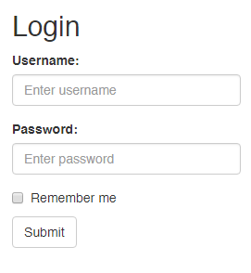
FORM
<div class="container">
<h2>Login</h2>
<form>
<div class="form-group">
<label for="email">Username:</label>
<input type=“username" class="form-control" id=“username" placeholder="Enter username">
</div>
<div class="form-group">
<label for="pwd">Password:</label>
<input type="password" class="form-control" id="pwd" placeholder="Enter password">
</div>
<div class="checkbox">
<label><input type="checkbox"> Remember me</label>
</div>
<button type="submit" class="btn btn-default">Submit</button>
</form>
</div>
Notes:
Explain “form-group” and “form-control”

Slide 13
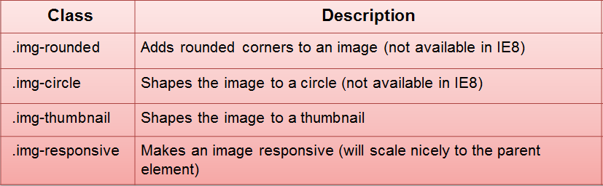
<img> Classes
The classes below can be used to style any image:
Example :
<img src=“image.jpg" class="img-responsive" alt=“My Image">

Slide 14
Thank You

